Slide 1
AI Teaching Assistant Chatbot using RAGs
Reporters: Liangqi Chen, Tony-Yonghao Shi, Will-Yuchuan Li, Felix-Yiping Fan

Slide 2
INDEX
I、 Brief introduction
II、 Methodology
III、Experimental Result
IV、Conclusion

Slide 3
Brief introduction
This project is to develop an AI Teaching Assistant using large language models. By leveraging Retrieval-Augmented Generation (RAG), the chatbot can dynamically fetch relevant information from course materials, lecture PDFs, and video transcripts, ensuring accurate and context-aware responses. The AI-powered TA will answer questions, provide explanations, and help facilitate discussions, simulating the role of a human teaching assistant.

Slide 4
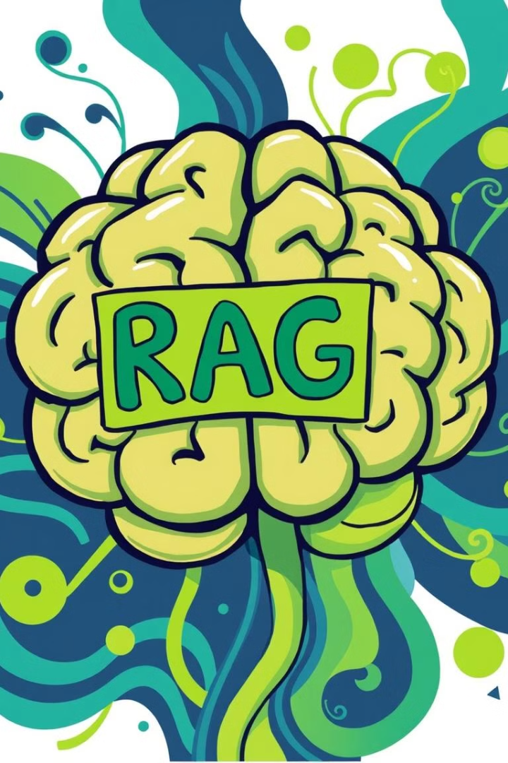

Extracting Insights from Text and Multimedia
We have developed self-RAG and graph RAG algorithms to extract information from a diverse range of text and multimedia content. We have developed a Streamlit-based API that supports reading and analyzing video streams, PDF files, various text documents, and HTML content directly through an integrated interface.

Slide 5
A Comprehensive RAG Dataset
Our dataset features a wide range of content, including RAG course videos, lecture PDFs, and relevant HTML documents. This collection provides a multimodal knowledge base that combines textual and visual information, ensuring comprehensive coverage of diverse topics.
This diverse collection enables comprehensive evaluation of our RAG algorithms across various document types, including video transcripts, structured PDFs, and web content. By leveraging different modalities, our system is capable of robust information retrieval and accurate response generation across knowledge-intensive tasks.

Slide 6
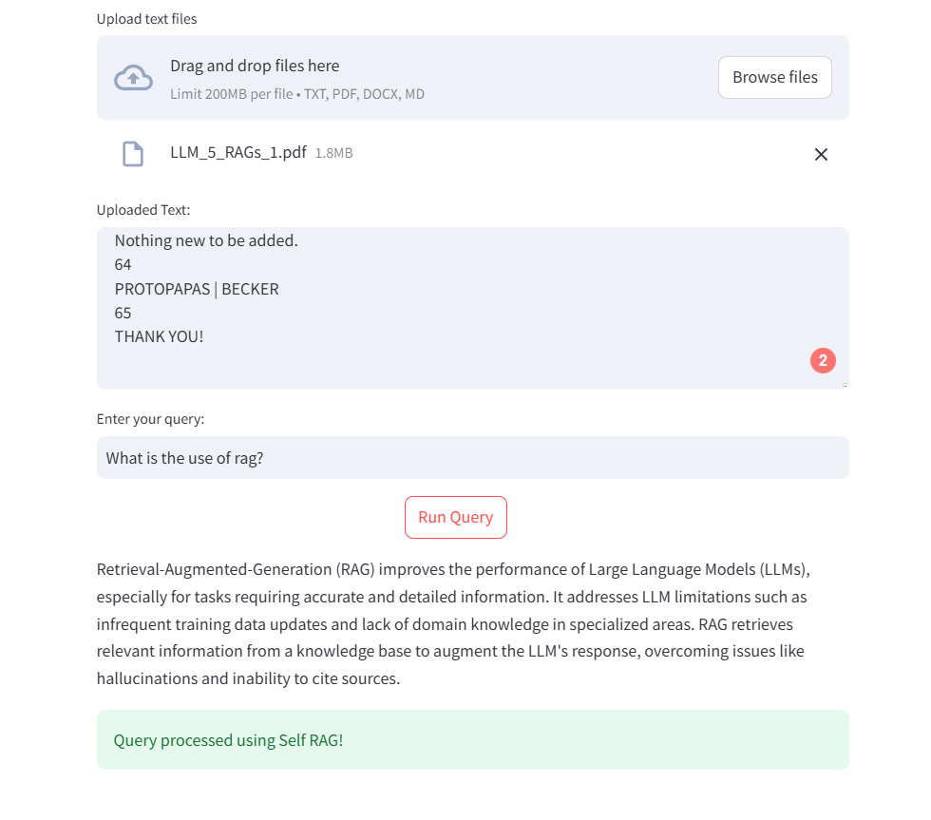

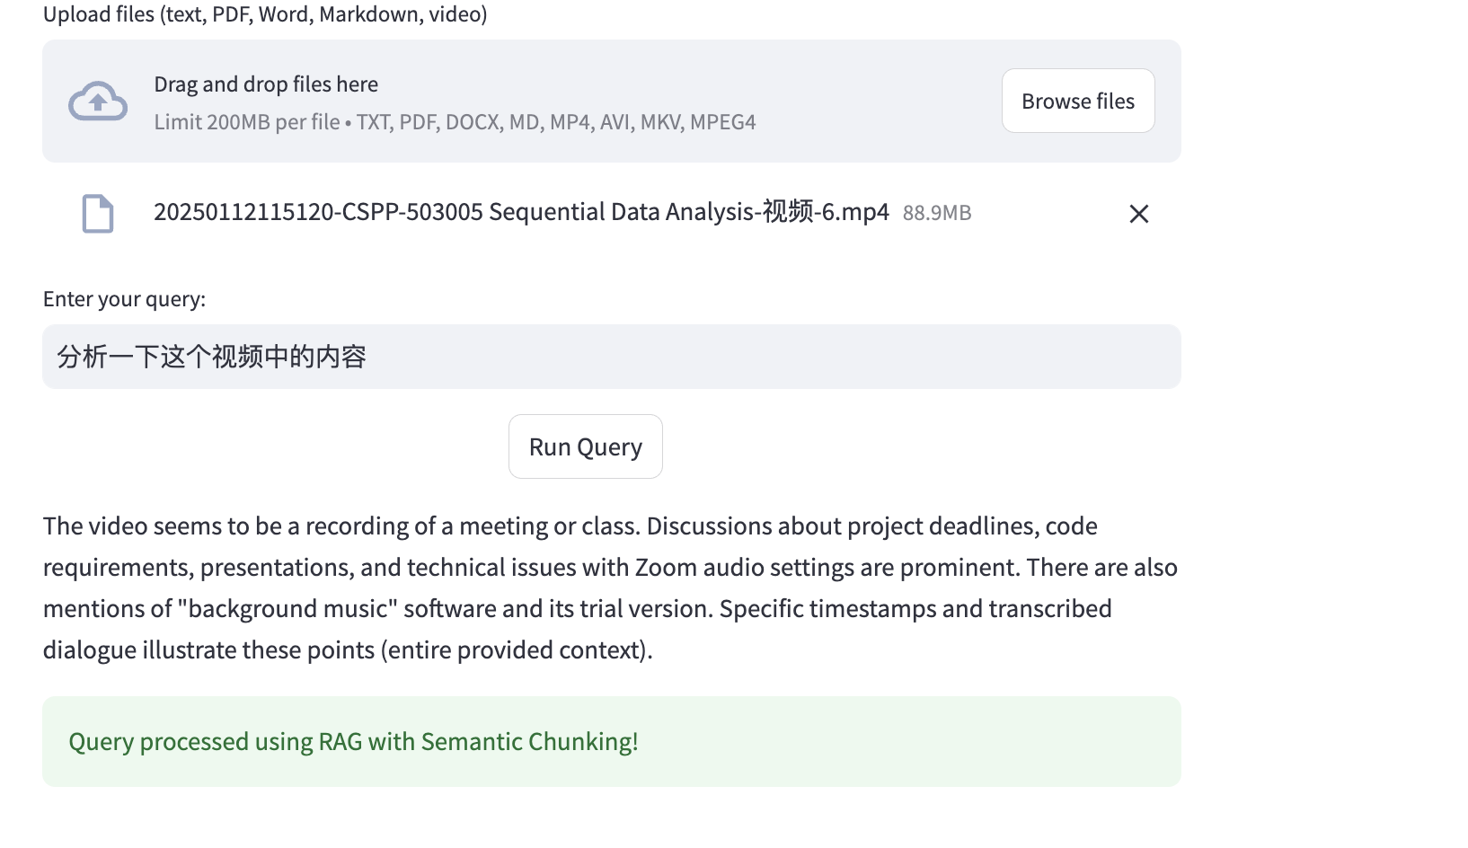
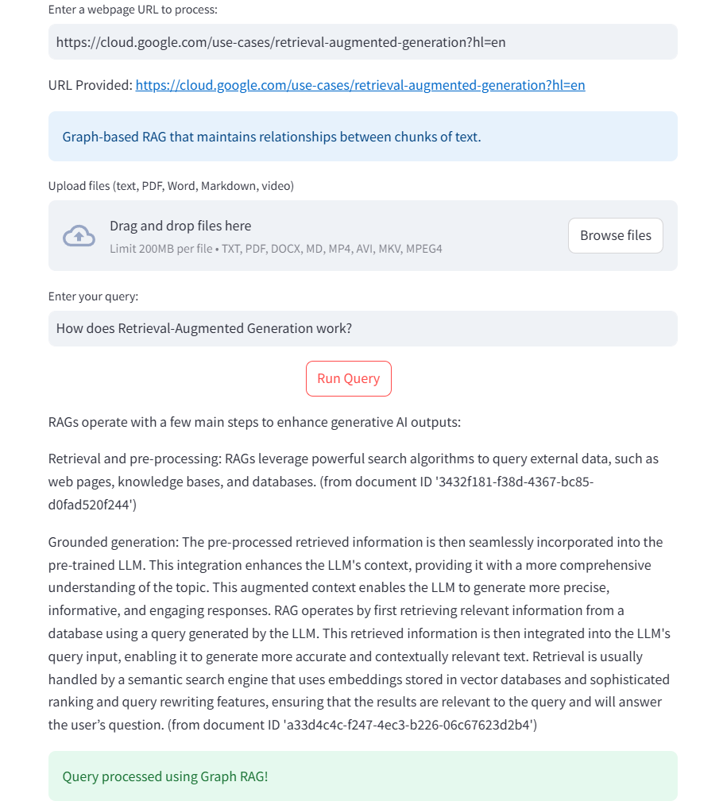
Results based on multi-format input
Multi-format input includes TXT, PDF, DOCX, MD,MP4,AVI,MKV,MPEG4 and URL. The platform also support combination of files.
Our project has developed an immediate classroom Q&A system. Students are able to upload learning resources or links that require clarification directly onto the integrated platform and pose their questions, after that They will receive answers.
Besides, Should the uploaded resources lack the knowledge necessary to address the questions, the platform will provide an honest feedback indicating the situation.

Slide 7
The meaning of the Q&A system
From the students' perspective, this system can more effectively assist them in comprehending the classroom teaching content and provide targeted answers to their questions regarding the course materials.
In terms of the combination of RAG and LLM, the RAG with limited reliable resources can greatly enhance the credibility of the LLM's responses. Moreover, the flexible input methods and the combination of files can address the issue of restricted input resources, which may otherwise prevent obtaining relevant answers.

Slide 8
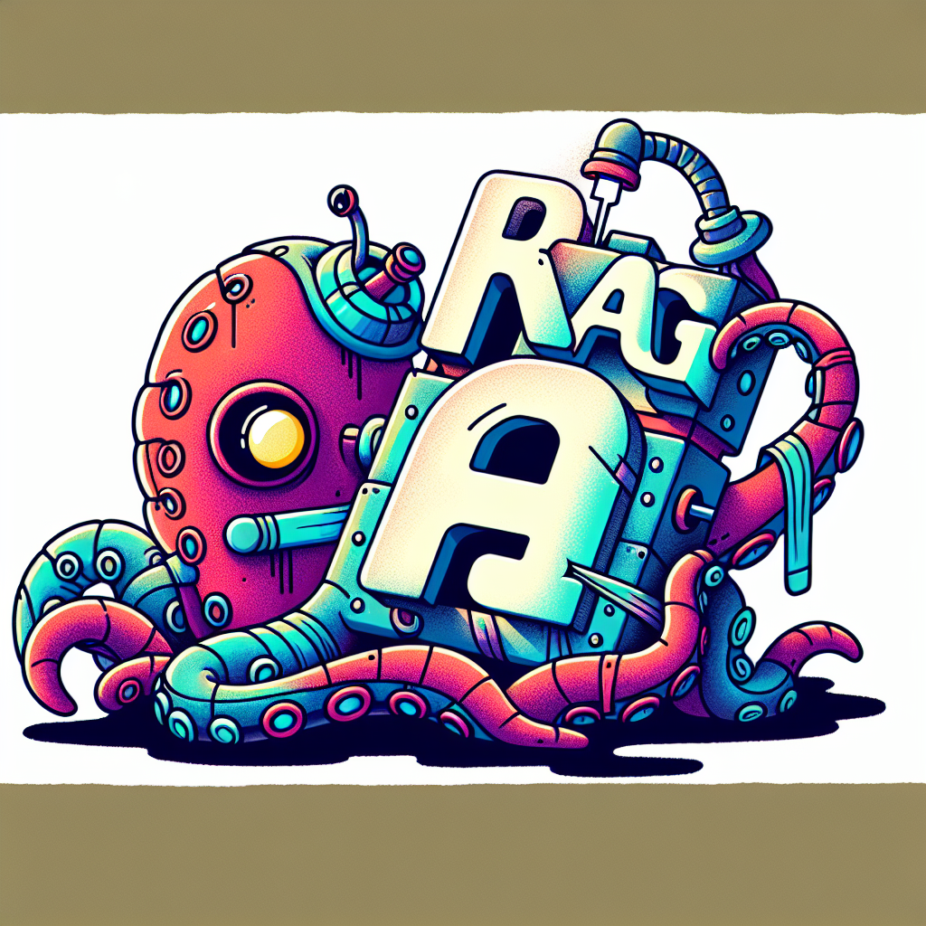
What we have learned from the problem
Learned framework of self rag and graph rag to achieve RAG-based answer retrieval and improve the accuracy of chatbots to specific domain questions
Learned how to convert PDF files , documents, HTML and video transcripts into machine-understandable data, index, and store them for subsequent retrieval. Learn how to leverage video content by transcribing video to text using tools like Whisper.
learned how to use Streamlit to build a fast, interactive front-end page
Most importantly, through this program, we have developed teamwork skills

Slide 9

Improvements can make
Add a user testing session where students and teachers are invited to give feedback on early prototypes.
In the data pre-processing stage, data cleaning and denoising steps are added to improve the quality of the input data. Design weights and priorities for different types of data (forum posts, handout PDFs, video transcriptions) to provide more relevant responses.
Learn to use tools like DeepBrain, D-ID, and more to convert text to video to increase the immersion and engagement of bot interactions.

Slide 10
THANK YOU FOR LISTENING!

